Slide 1
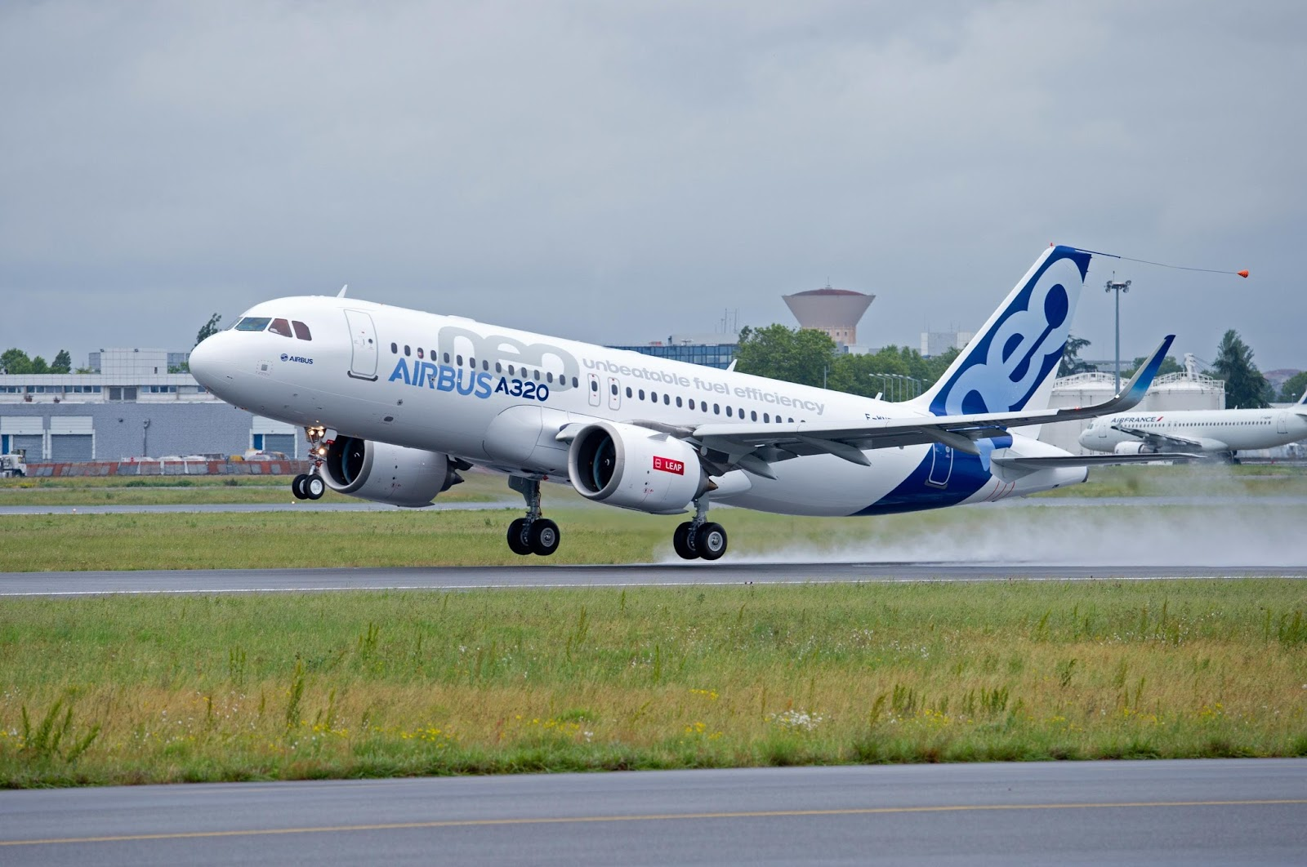
Flight Price and Customer Satisfaction Prediction

Slide 2


Problem Statement
"The 'Flight Price Predictor and Customer Satisfaction Classifier Project' aims to enhance user experience and operational efficiency by providing accurate predictions and actionable insights. By leveraging datasets containing information about flight details (such as departure time, source, destination, and airline type) and customer feedback (including demographics and service ratings), this project seeks to build two models: a regression model to predict flight ticket prices and a classification model to predict customer satisfaction levels. The project involves data processing, cleaning, and feature engineering, followed by training and deploying the models in a Streamlit application. The application will allow users to input relevant filters and receive predictions for flight prices and customer satisfaction levels, thereby improving decision-making and customer service."

Slide 3



approach
Data Preprocessing
Ensure Data Quality
Building Models
Models Predicting Price and Satisfaction
Save models in MLflow’s model registry
Integrate MLflow
Streamlit
Build an interactive Streamlit app

Slide 4





Technologies Used
Python
MLFLOW
Streamlit
"Python is essential in data cleaning, preprocessing, and Exploratory Data Analysis (EDA) due to its powerful libraries like Pandas, NumPy, Matplotlib, and Seaborn. These tools streamline handling large datasets, uncovering patterns, and providing deep insights. Additionally, it supports Machine Learning with libraries like Scikit-learn and TensorFlow."
"MLflow is an open-source platform designed to manage the entire machine learning lifecycle. It offers tools for experiment tracking, model packaging, and deployment, ensuring reproducibility and collaboration. MLflow integrates with various machine learning libraries and programming languages, making it versatile and easy to use."
Streamlit is an open-source Python framework for creating interactive web apps with minimal code, ideal for data science and machine learning projects. It integrates easily with libraries like Pandas and Matplotlib, offering fast deployment and real-time interactivity.

Slide 5
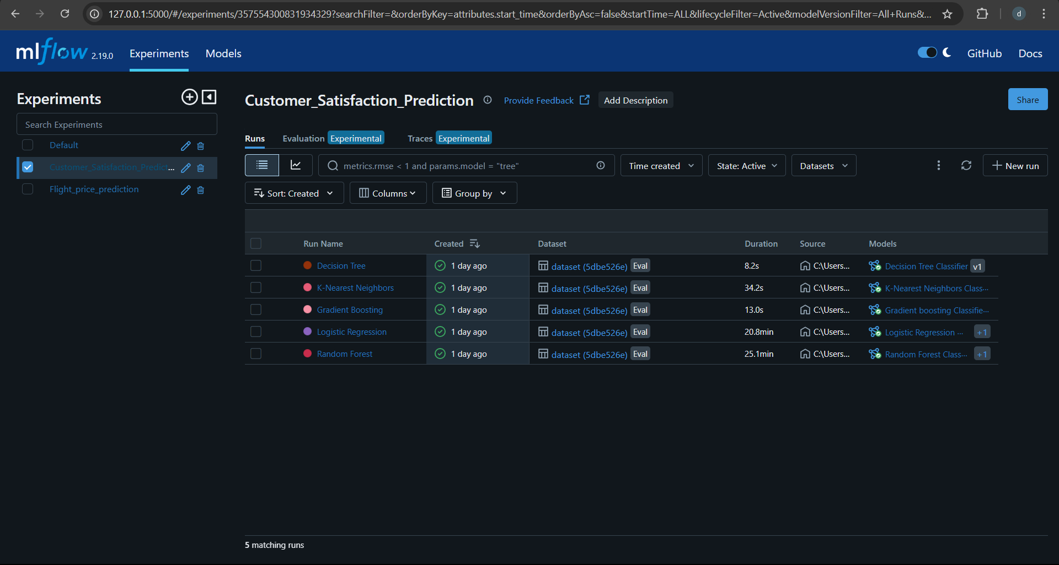

Slide 6
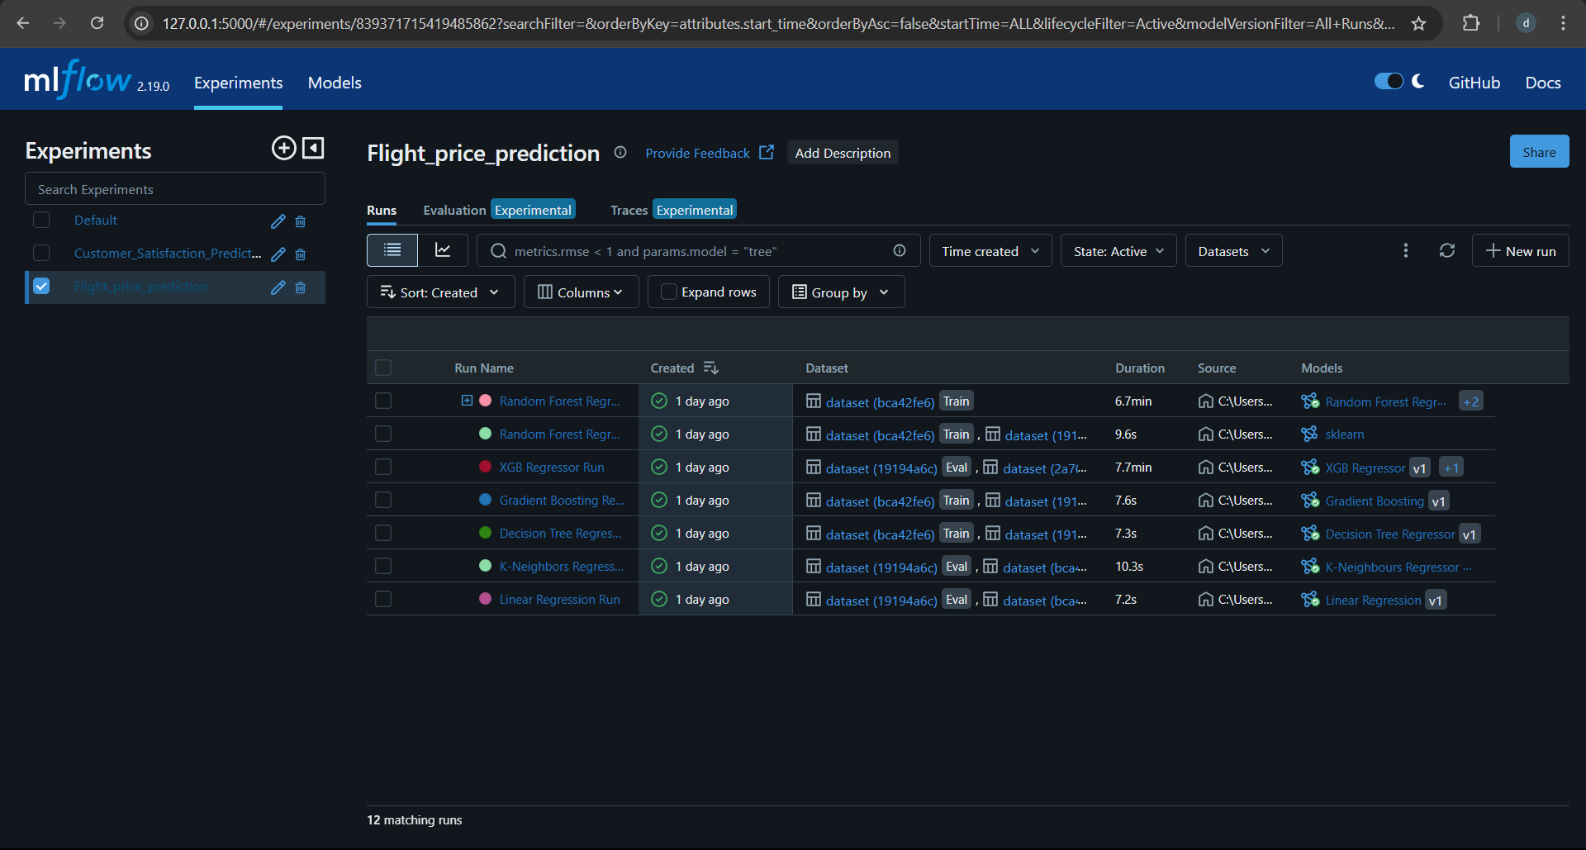

Slide 7
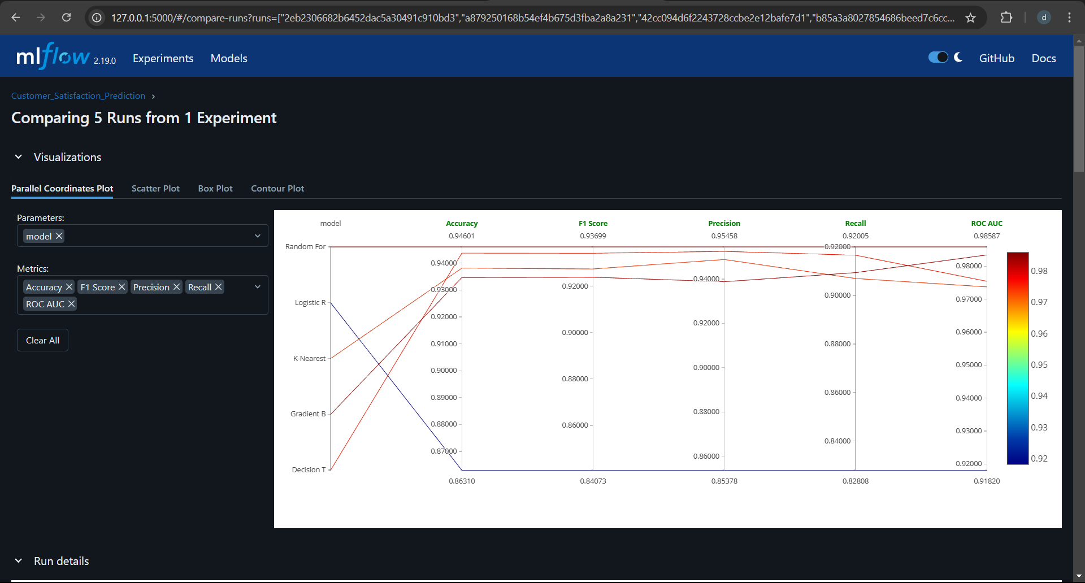

Slide 8
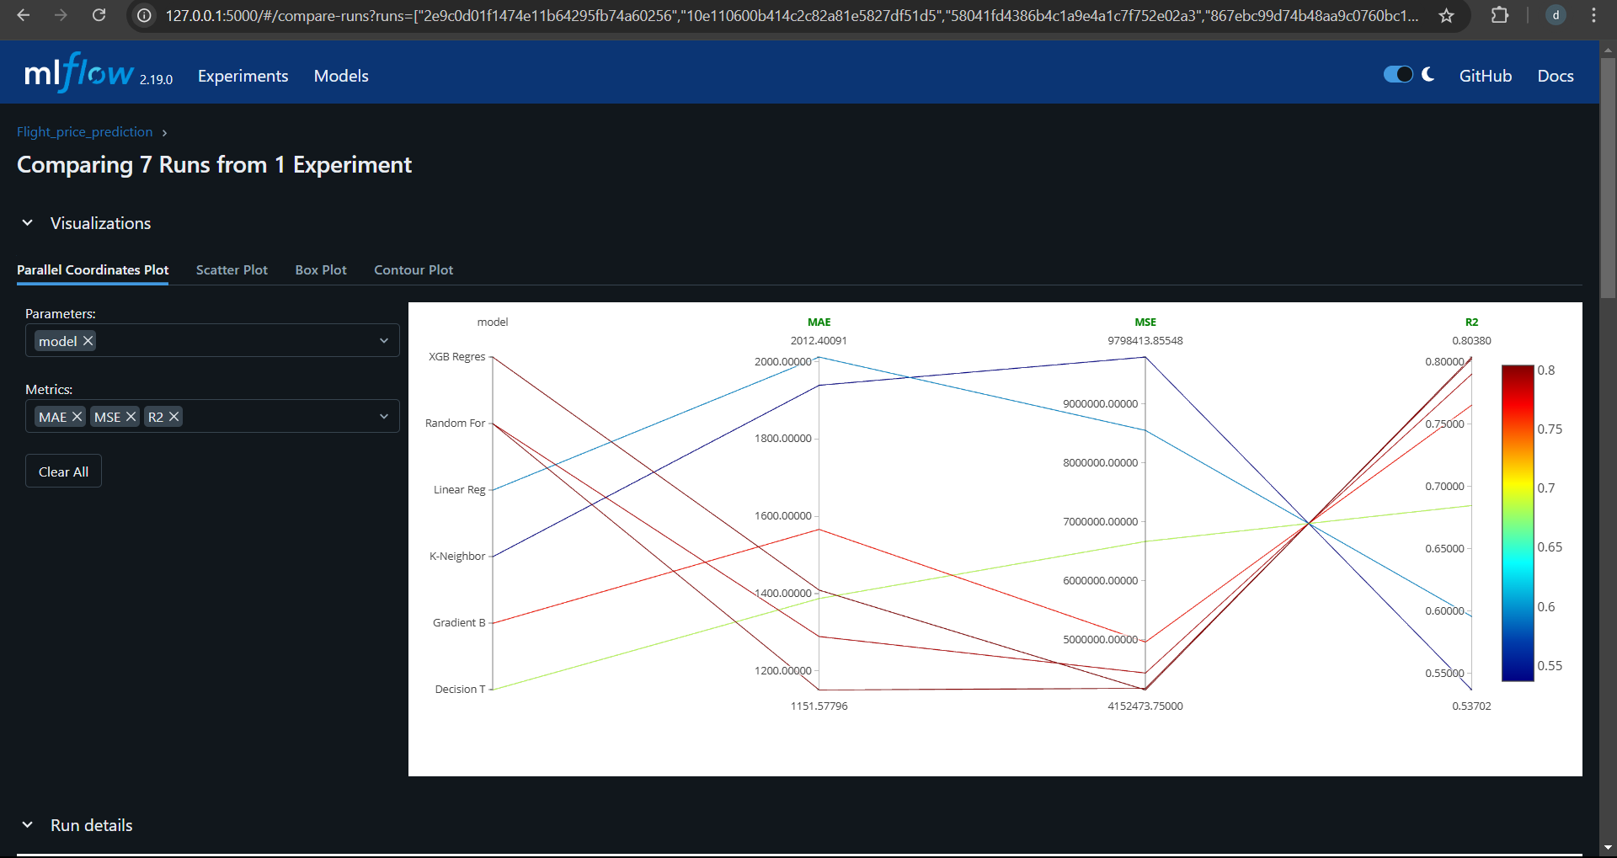

Slide 9
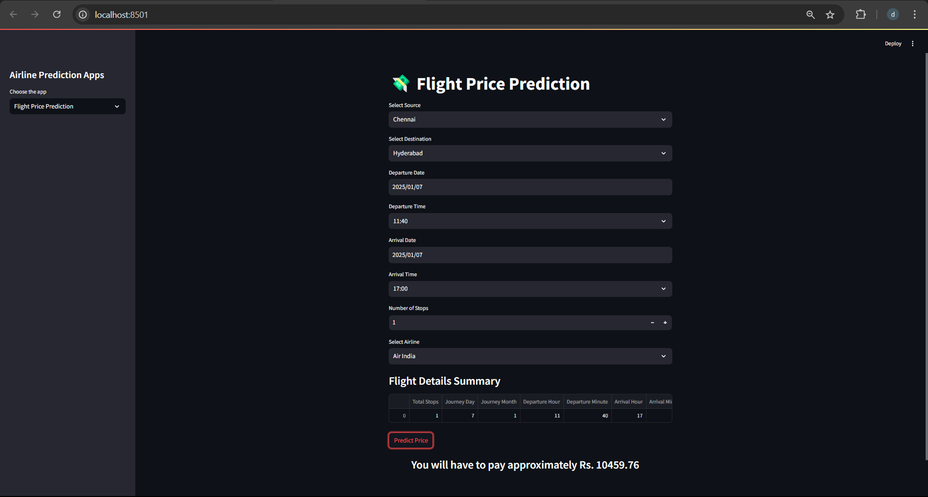

Slide 10
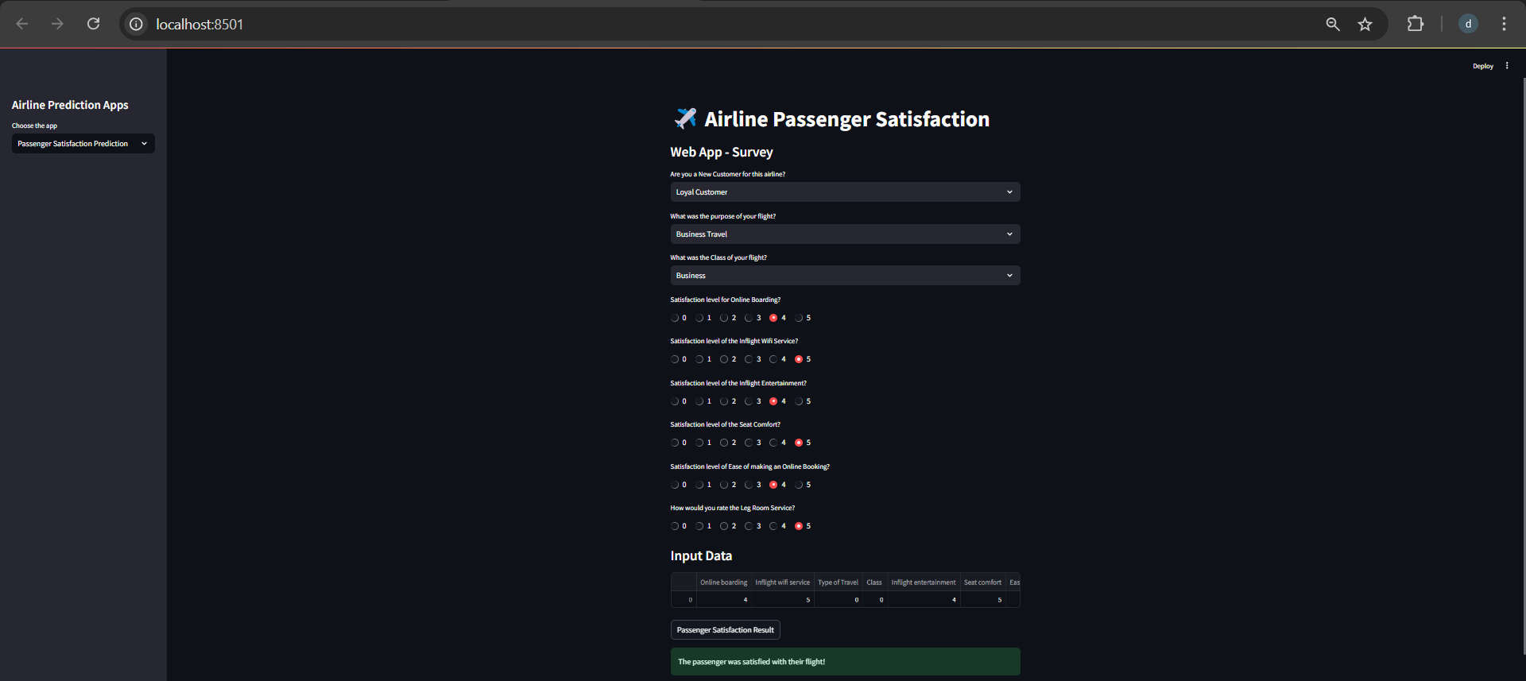

Slide 11


Thank You
The door to success is always open to those who are willing to work hard.

